Slide 1
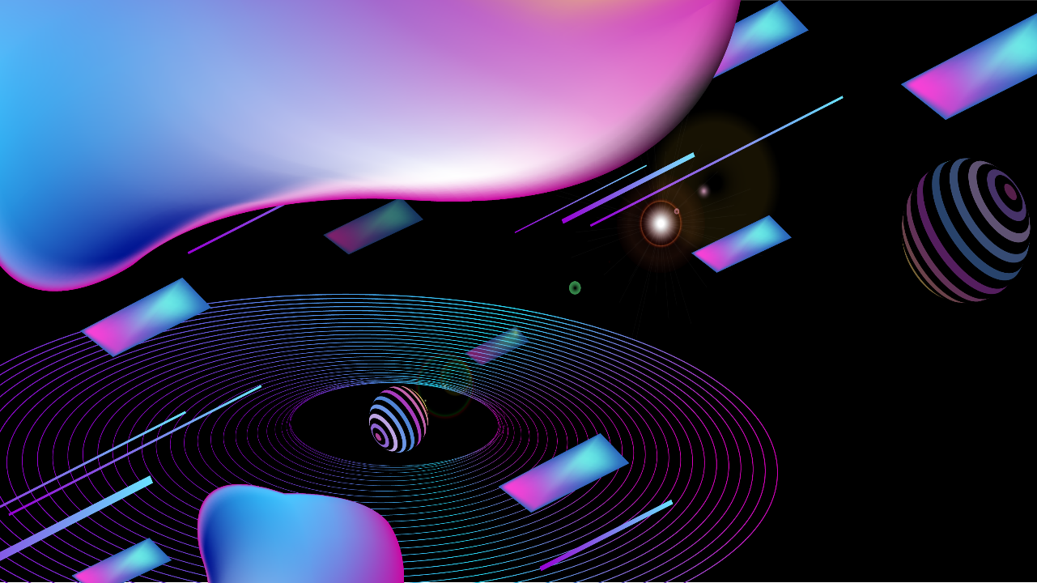
Generative Adversarial Networks (GANs) for Video Augmentation
Reporter

Slide 2
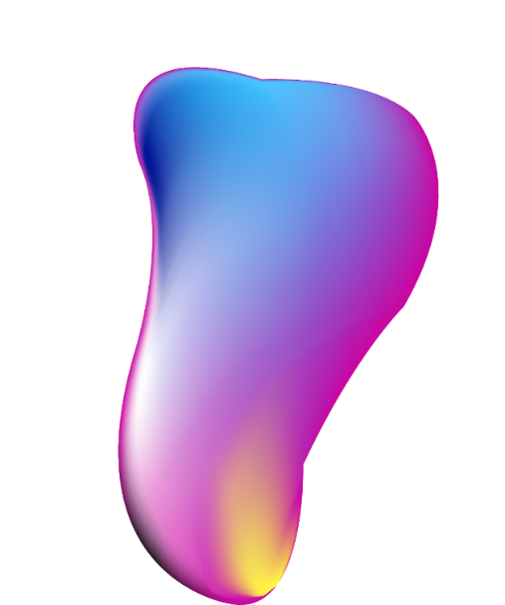
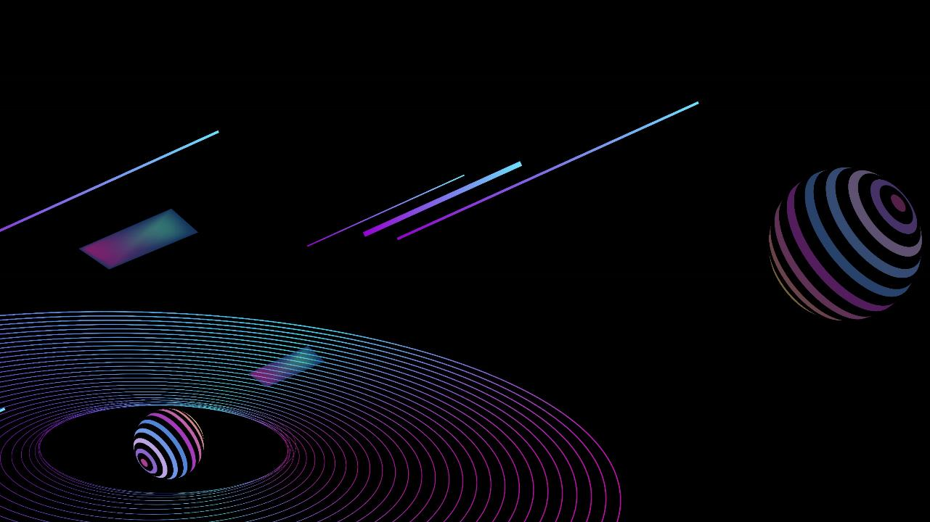

CONTNTES
Eye
01
02
03
Record
Introduction to GANs
GANs for Video Augmentation
Technical Implementation
04
05
06
Case Studies
Future Directions
Conclusion

Slide 3
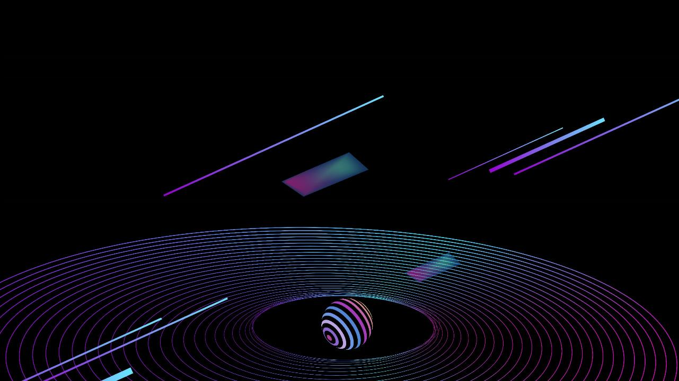


Introduction to GANs
01.

Slide 4

Definition and Mechanism
1
2
3
What is a GAN?
How do GANs work?
Applications of GANs
GANs are a class of machine learning frameworks designed to generate synthetic data. They consist of two neural networks, a generator and a discriminator, that compete against each other to improve the quality of generated samples.
The generator creates fake data while the discriminator evaluates its authenticity. This adversarial process continues until the generator produces data that the discriminator can no longer confidently identify as fake.
GANs have been used in various fields including image synthesis, style transfer, and data augmentation, allowing for the enhancement of datasets with synthetic examples that maintain the original data's characteristics.

Slide 5
Importance of Video Data
Necessity for Augmentation
Data augmentation is crucial in machine learning to improve model robustness. In the case of video data, it can enhance the variety and volume of training data available.
Challenges with Video Data
Video data poses unique challenges such as high dimensionality and temporal coherence, making traditional augmentation techniques less effective.

Slide 6
GANs for Video Augmentation
02.

Slide 7
Process Overview
Input Video to Image Generation
Output Images
The method involves converting video clips into frame images that can be manipulated. This allows for the application of GANs to each frame for generating new image variations.
After training, the GAN produces images that serve as augmented data, introducing variations that help to improve the performance of machine learning models on video data.
Training the GAN
The GAN is trained using a dataset of original video frames, letting the generator learn to create variations that are visually and contextually similar to the real frames.

Slide 8
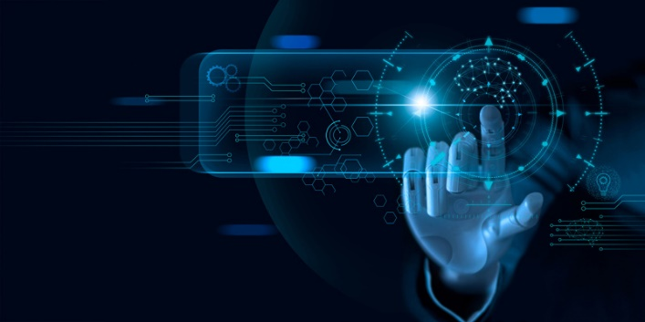

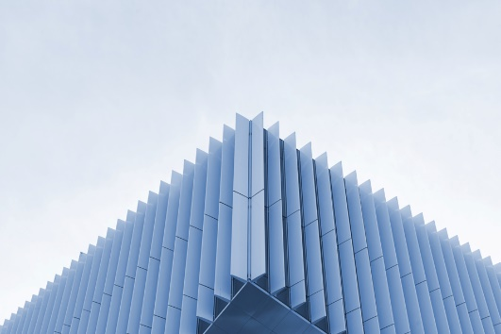
Benefits of Using GANs
01
02
03
Increased Dataset Diversity
Reduction in Overfitting
Improved Model Performance
GAN-generated images can significantly increase the diversity of the dataset, providing an array of variations in lighting, angles, and movement, which enhances model training.
By using augmented images, models can generalize better and reduce the risk of overfitting to a limited set of original data.
The introduction of augmented data via GANs can lead to improved performance metrics in tasks like object detection, action recognition, and more within video analysis.

Slide 9
Technical Implementation
03.

Slide 10
Frameworks and Libraries
Custom GAN Models
Developers can create custom GAN architectures tailored to specific video augmentation needs, allowing for flexibility in the augmentation process.
Popular GAN Implementations
Libraries such as TensorFlow and PyTorch provide frameworks for building and training GANs, making it accessible for practitioners to implement video augmentation techniques.

Slide 11
Evaluation of GAN Performance
Qualitative Analysis
Visual inspection of the generated images is also essential for determining how well the GAN has captured the underlying characteristics of the training data.
Metrics for Evaluation
Performance can be evaluated using metrics such as Inception Score (IS) and Fréchet Inception Distance (FID) to assess the quality of the generated images compared to original frames.

Slide 12
Case Studies
04.

Slide 13
Successful Applications
01.
02.
Use in Sports Analytics
Medical Imaging Enhancements
GANs have been successfully implemented for augmenting videos in sports analytics, generating additional training data that assists in player performance analysis.
In medical imaging, GANs have provided augmented data to improve training sets for diagnostic models, aiding in the classification of imaging data.

Slide 14

Challenges Faced
Quality of Generation
Computational Requirements
One of the major challenges is ensuring the quality of the generated images match or exceed the benchmarks needed for the specific application.
Training GANs, especially on video data, requires substantial computational resources, which can be a limiting factor for many researchers and practitioners.

Slide 15
Future Directions
05.

Slide 16
Innovations in GAN Design
Real-time Applications
There is ongoing research into making GANs more efficient to enable real-time video augmentation, opening doors for immediate applications in various fields.
Improved Architectures
Future GAN designs aim to incorporate advanced techniques such as attention mechanisms to enhance the learning process and improve the generator's output.

Slide 17

Expanding Applications
Cross-Modal Applications
Exploring the application of GANs for generating multimodal data (e.g., combining video with corresponding audio enhancements) could provide richer datasets for training.
Greater Industry Adoption
As the technology matures, higher adoption rates in industries such as entertainment, surveillance, and autonomous driving are anticipated.

Slide 18
Conclusion
06.

Slide 19
Summary of Benefits
Key Takeaways
Looking Ahead
GANs provide a powerful tool for augmenting video data, enhancing dataset diversity, improving model robustness, and ultimately leading to better performance in machine learning tasks.
The future of GANs in video augmentation is promising, with continued innovation likely to yield even greater results and applications in various fields.

Slide 20
Xie
Xie
Big
Home
Reporter

